Slide 1
Monk Sherborne Solar Farm

Slide 2
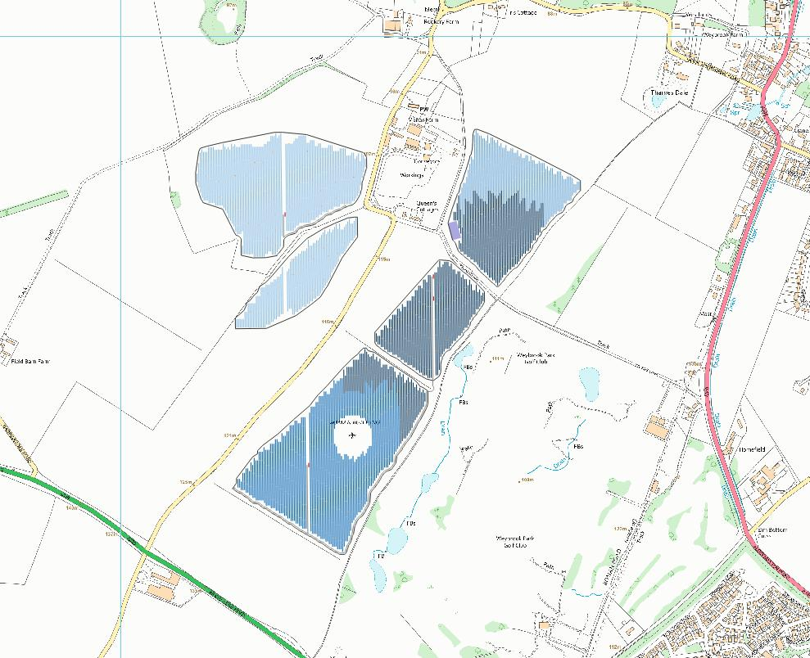
Monk Sherborne Solar Farm - Overview
Proposals for:-
Up to 28MW solar farm
82.9 hectares (204 acres)
In excess of 10% Biodiversity Net Gain
Community Benefit Fund

Slide 3
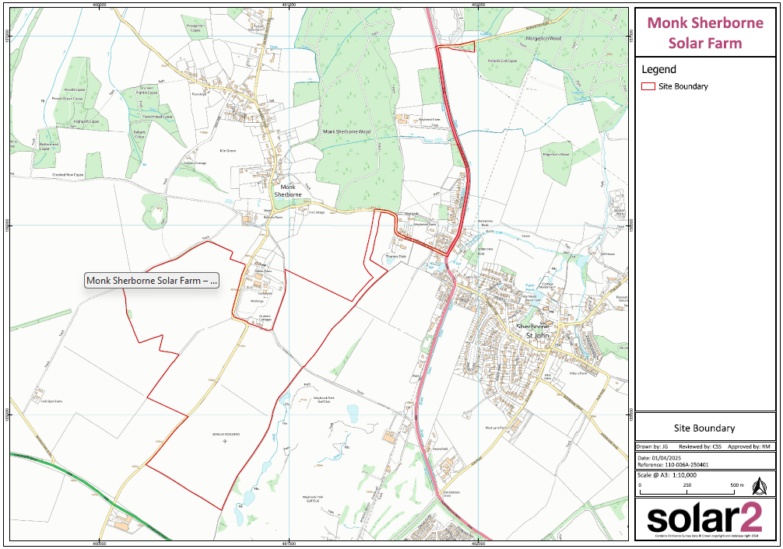
Monk Sherborne Solar Farm – Site Boundary

Slide 4
Public Consultation
6th March 2025 public exhibition at Monk Sherborne Village Hall
2006 notification leaflets sent to local residents
66 local residents attended the public consultation
59 feedback forms received
49% either quite
of very dissatisfied
with the information received
20% either very
or quite satisfied with
the information received

Slide 5
Public Consultation – Feedback Results
79% either
strongly or somewhat
opposed
12% either
strongly or somewhat
supportive
36% raised concerns regarding the impact on rural views and wildlife
32% requested an additional meeting with Solar2
17% raised concerns regarding food security

Slide 6
Monk Sherborne Solar Farm – Community Benefit Fund
Other UK solar farm operators have apparently offered considerably more community benefit than the value you propose.
How is the Community Benefit Fund agreed?
At present, there is no industry standard for the community benefit fund. Recurrent Energy are currently working with the steering group at Solar Energy UK, to achieve an industry standardised approach across all solar projects. Once this is established, the proposed development will provide a community benefit fund in line with this approach. Rest assured; we are fully committed to providing a fund should Monk Sherborne Solar Farm be successful in securing planning permission. This would then be secured through a separate legal agreement, post-planning consent.

Slide 7
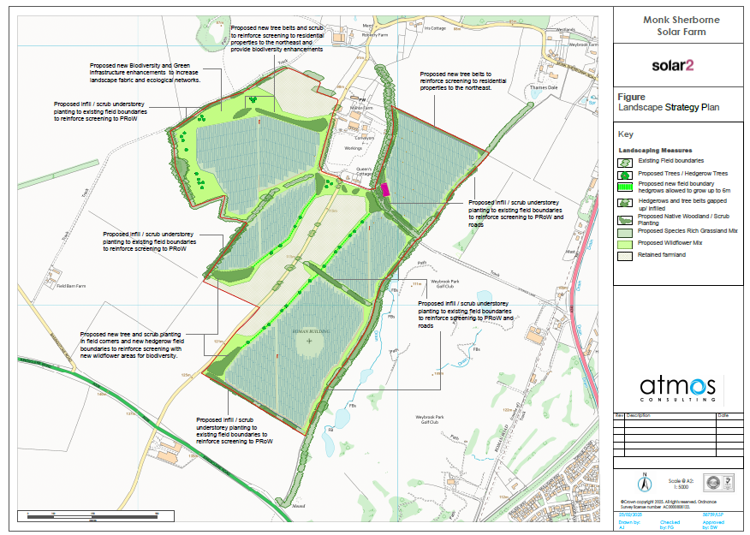
Landscape Mitigation Plan
Q. What have you allowed for in your budget for planting/screening works?
A. Planning condition will secure the agreed landscape mitigation plan.
The placement of panels is designed to sensitively maximise the land whilst respecting heritage, wildlife, public right of ways and other aspects of the land whilst creating Biodiversity Net Gain (BNG).

Slide 8
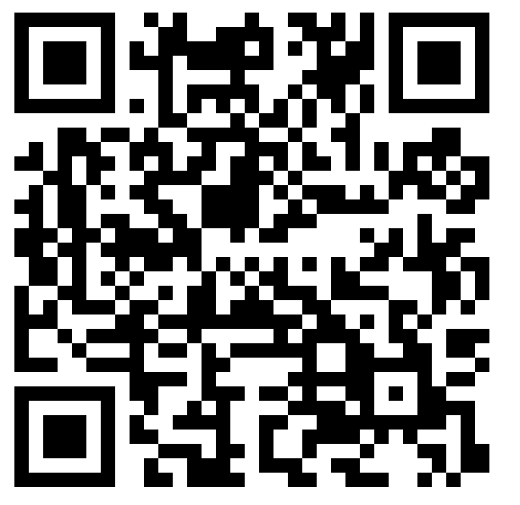
Questions
Q. How is the Biodiversity Net Gain calculated and what biodiversity measures will be executed on site?
A. Biodiversity Net Gain (BNG) is measured using a standardised metric, the Statutory Biodiversity Metric, which calculates biodiversity value in "biodiversity units" based on habitat size, quality, location, and type, both before and after development.
For further information see: https://www.gov.uk/guidance/understanding-biodiversity-net-gain#measuring-biodiversity-
Q. Post construction, how will maintenance be carried out (including the land under the panels)?
A. Maintenance and management will be secured via a planning condition (Landscape, Ecological Management plan) which will detail regular maintenance and include a monitoring schedule. Panels will be high enough to allow for sheep grazing, however if there is no desire for this the site could be managed mechanically. Post construction, on-site traffic will be minimal, approx. once a month, by a small light good vehicle (LGV).

Slide 9
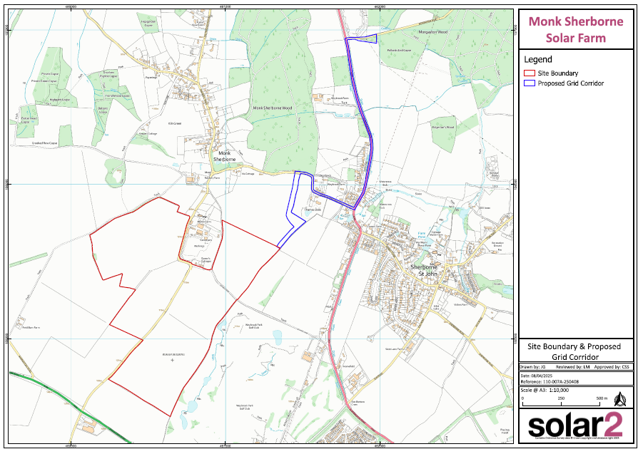
Proposed Grid Access Route
How will the solar farm be connected to the grid (route and method i.e. cabling underground?
There will be a small substation that the generated energy will be connected to (PoS – Point of Supply), via a cable route, this will feed into the Distribution (DNO) infrastructure (in this case an overhead line at Morganston Road (PoC – Point of Connection).

Slide 10
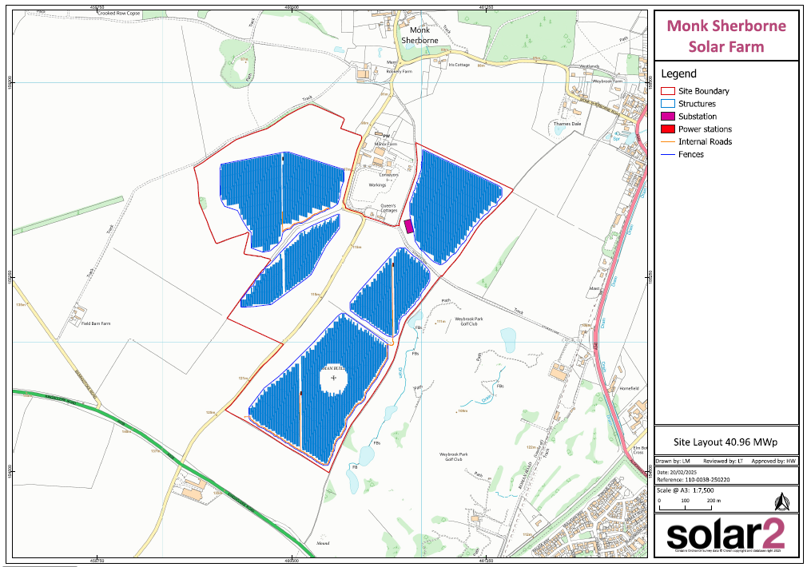
Proposed On-site Infrastructure
In addition to panels, what other infrastructure will be on site?
On-site substation
Inverters
Switchgear containers
Spare parts containers
CCTV
Transformer
Agricultural fencing

Slide 11
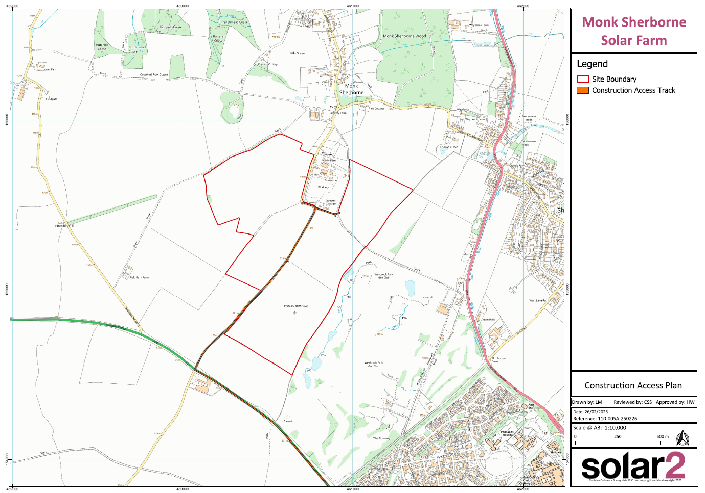
Construction Route
Q. May we have a copy of the Solar Farm Traffic surveys? If not, please can you share details of how access to the construction sites will be managed (esp. safety)? A. Proposed vehicle numbers will be submitted with the formal planning submission. The Local Highways Authority will review this and provide their comments accordingly. A detailed Construction Traffic Management Plan (CTMP) will be secured through planning condition. This will include details of any required mitigation/management.
Q. Where will the panel assembly and parking be situated for the site during the construction period. What will happen to this plot of land after the solar farm is built? A. The layout will include a construction compound area within the red line boundary of the site which will include a laydown area and off-road parking. Likely this will be the last area to be developed within the site boundaries.

Slide 12
Questions
Q. We understand that the tenancy transfers from Solar2 to Recurrent Energy following the application approval. How can you guarantee that any agreements are honoured by Recurrent Energy? A. Recurrent Energy own the SPV (Special Purpose Vehicle) for Monk Sherborne Solar Farm and are working with Solar2 on the project. Both parties are in full agreement of all commitments which will be a part of the planning application. All requirements and conditions of the agreed planning approval (if gained) must be fully complied with.

Slide 13
Feedback – Leaflet
We fully acknowledge that an additional leaflet for a Welsh project was distributed in error to local residents. This was down to human error.
Issues have been raised by residents reporting that they did not receive notification of the consultation. This has been investigated and both Royal Mail and the distribution company, have confirmed all leaflets were delivered.

Slide 14
Feedback
Feedback period – just over 3 weeks (22 days) from public consultation exhibition
Planning application will be submitted early to mid-May 2025
Additional opportunity to provide feedback, support or opposition for the project via the planning portal

Slide 15
THANK YOU

